Slide 1

Data Mining – Meeting 2
Roi Yehoshua
Partially based on slides of Noam Koenigstein
The Open University

Slide 2
Agenda
Data Preprocessing
Data Types
Data Quality Problems
Graph Representation of Data
Data Cleaning
Data Integration and Transformation
Data Reduction
Preprocessing with Weka

Slide 3
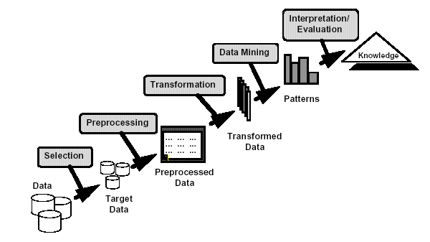
Chapter 3

Slide 4
Data In Reality
What we have? | What DM Tools Need?
Several tables / databases | One table of data
Missing metadata | Clear meaning of each attribute
Out-of-range values | Well-defined domain of each attribute
Missing values | Values of all attributes
Noisy values | Data reliability
Redundant information | No duplicate information
Incosistent data | Data consistency

Slide 5
Why Is Data Dirty?
Incomplete data may come from
Not applicable data value when collected
e.g., final grade of student who has not completed his studies
Considered unimportant at the time of data collection
Human/hardware/software problems
Noisy data may come from
Systematic Noise-
In the final grade, the final project got 50% instead of 20%
In images- some burned sensors cause the same pixels to be black in all images
Random Noise-
Inaccuracy in measurements (e.g., of length or weight)
Random typos when inserting students grades
External factors – In rating data, the user may have a bad/good mood which effects his ratings scale

Slide 6
Why Is Data Dirty?
inconsistent: containing discrepancies in codes or names
e.g., Age=“42” Birthday=“03/07/1997”
e.g., Was rating “1,2,3”, now rating “A, B, C”
e.g., discrepancy between duplicate records

Slide 7
Why Is Data Preprocessing Important?
No quality data, no quality mining results!
Quality decisions must be based on quality data
e.g., duplicate or missing data may cause incorrect or even misleading statistics.
Data warehouse needs consistent integration of quality data
Data extraction, cleaning, and transformation comprises the majority of the work of building a data warehouse

Slide 8
Major Tasks in Data Preprocessing
Data cleaning
Fill in missing values, smooth noisy data, identify or remove outliers, and resolve inconsistencies
Data integration
Integration of multiple databases, data cubes, or files
Data transformation
Normalization and aggregation
Data reduction
Obtains reduced representation in volume but produces the same or similar analytical results
Data discretization
Part of data reduction but with particular importance, especially for numerical data

Slide 9
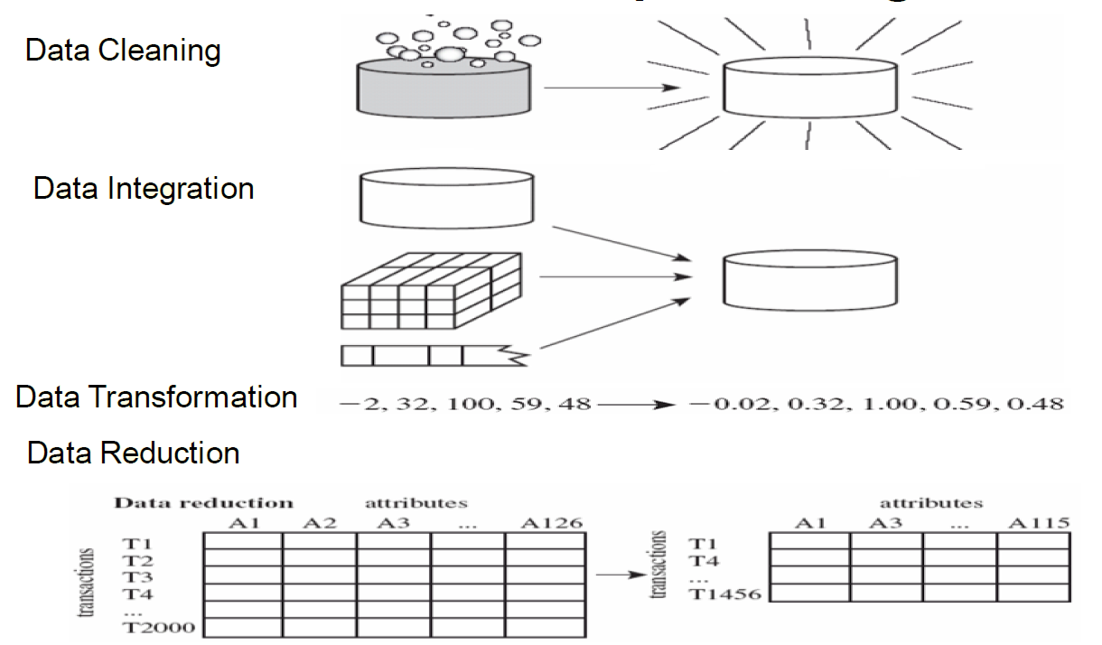
Forms Of Data Preprocessing

Slide 10
Types Of Attributes
Three major types of attributes:
Nominal (a.k.a categorical) — values from an unordered set, e.g., color, profession. The values of a nominal attribute are symbols or names of things.
Ordinal — values from an ordered set, e.g., military or academic rank. Ordinal attributes may also be obtained from the discretization of numeric quantities.
Numeric attributes
Discrete – has a finite or countable infinite set of values, e.g., age, drink_size, customer_ID
Continuous — real numbers, e.g., weight

Slide 11
Data Types
Categorical
Numerical
Continuous
Discrete
Interval
Ratio
Ordinal
Periodic
Coding
Nominal
Binary

Slide 12
Data Types In Weka files
@relation heart-disease-simplified
@attribute age numeric
@attribute sex { female, male}
@attribute chest_pain_type { typ_angina, asympt, non_anginal, atyp_angina}
@attribute cholesterol numeric
@attribute exercise_induced_angina { no, yes}
@attribute class { present, not_present}
@data
63,male,typ_angina,233,no,not_present
67,male,asympt,286,yes,present
67,male,asympt,229,yes,present
38,female,non_anginal,?,no,not_present
...
Flat file in
ARFF format
12

Slide 13
WEKA only deals with “flat” files
@relation heart-disease-simplified
@attribute age numeric
@attribute sex { female, male}
@attribute chest_pain_type { typ_angina, asympt, non_anginal, atyp_angina}
@attribute cholesterol numeric
@attribute exercise_induced_angina { no, yes}
@attribute class { present, not_present}
@data
63,male,typ_angina,233,no,not_present
67,male,asympt,286,yes,present
67,male,asympt,229,yes,present
38,female,non_anginal,?,no,not_present
...
numeric attribute
nominal attribute
13

Slide 14
Mining Data Descriptive Characteristics
Motivation
To better understand the data: central tendency, variation and spread
Data dispersion characteristics
median, max, min, quantiles, outliers, variance, etc.
Numerical dimensions correspond to sorted intervals
Data dispersion: analyzed with multiple granularities of precision
Boxplot or quantile analysis on sorted intervals
Dispersion analysis on computed measures
Folding measures into numerical dimensions
Boxplot or quantile analysis on the transformed cube

Slide 15
Measuring the Central Tendency
Mean (algebraic measure) (sample vs. population):
Weighted arithmetic mean:
Trimmed mean: chopping extreme values
Median: A holistic measure
Middle value if odd number of values, or average of the middle two values otherwise
Mode
Value that occurs most frequently in the data
Unimodal, bimodal, trimodal
Empirical formula:
15

Slide 16
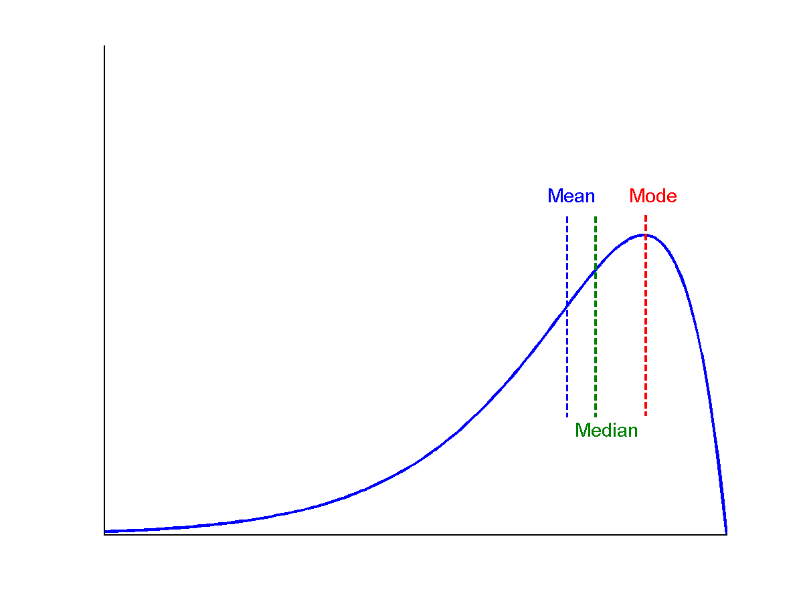
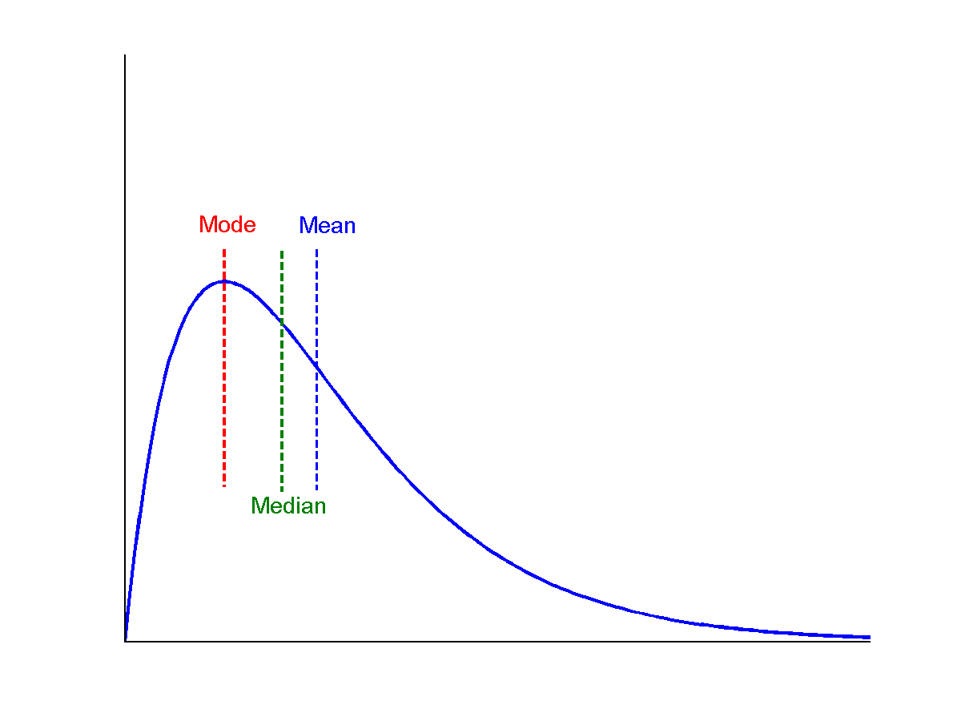
Symmetric vs. Skewed Data
Median, mean and mode of symmetric, positively and negatively skewed data

Slide 17
Measuring the Dispersion of Data
Quartiles, outliers and boxplots
Quartiles: Q₁ (25th percentile), Q₃ (75th percentile)
Inter-quartile range: IQR = Q₃ – Q₁
Five number summary: min, Q₁, M, Q₃, max
Boxplot: ends of the box are the quartiles, median is marked, whiskers, and plot outlier individually
Outlier: usually, a value higher/lower than 1.5 x IQR
Variance and standard deviation (sample: s, population: σ)
Variance: (algebraic, scalable computation)
Standard deviation s (or σ) is the square root of variance s² ⁽or σ²⁾
17

Slide 18
Properties of Normal Distribution Curve
The normal (distribution) curve
From μ–σ to μ+σ: contains about 68% of the measurements (μ: mean, σ: standard deviation)
From μ–2σ to μ+2σ: contains about 95% of it
From μ–3σ to μ+3σ: contains about 99.7% of it

Slide 19
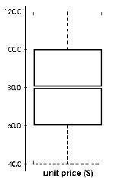
Boxplot Analysis
Five-number summary of a distribution:
Minimum, Q1, M, Q3, Maximum
Boxplot
Data is represented with a box
The ends of the box are at the first and third quartiles, i.e., the height of the box is IRQ
The median is marked by a line within the box
Whiskers: two lines outside the box extend to Minimum and Maximum, only if these values are less than 1.5 x IQR beyond the quartiles
Otherwise, the whiskers terminate at the most extreme observations
19

Slide 20
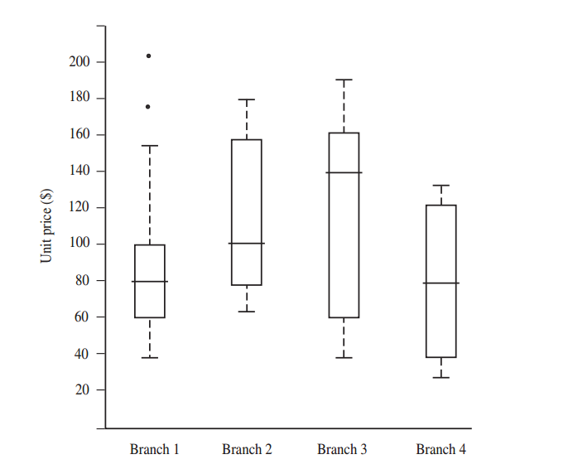
Box Plot Analysis
Taken from Han & Kamper Data Mining Book

Slide 21
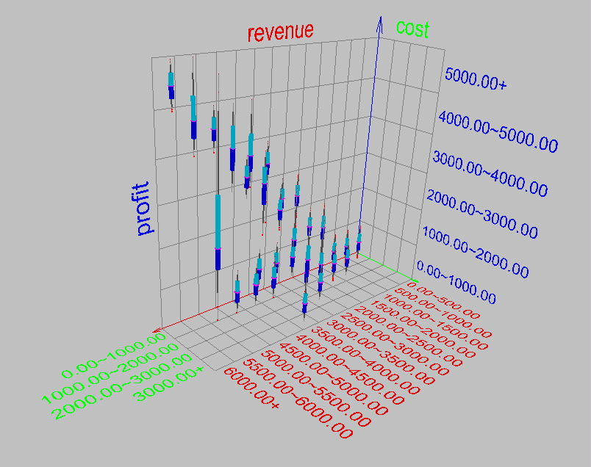
Visualization of Data Dispersion: Boxplot Analysis

Slide 22
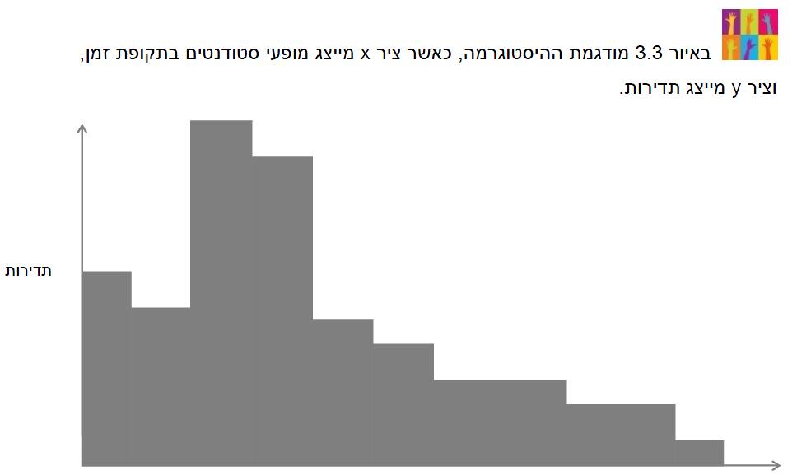
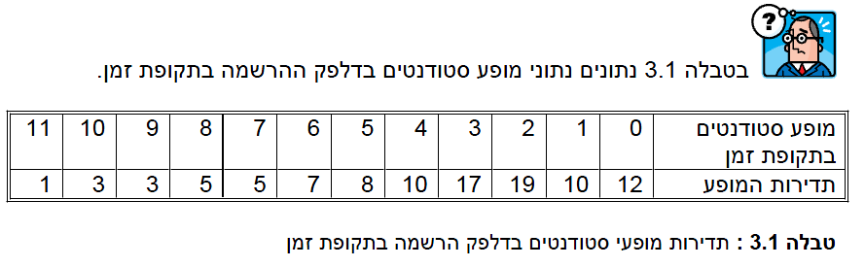
Histograms

Slide 23
Histograms
The goal: A visualization of data distribution
Building Histograms:
Sort data values in increasing order
Determine discrete intervals (bins)
k – number of bins h – bins width
If bins are too wide, we loose on resolution, but if bins are too narrow the histogram is not smooth
Different methods
Calculate the frequency of each bin (count/width)
Plot

Slide 24



Number of Bins and Width
Fixed width:
Square Root choice:
Take the square root of the number of data points
Sturge’s formula:
Implicitly based on the range of data points
Scott’s choice:
Based on the standard deviation of the data

Slide 25
Scatter Plots
A scatter plot or scattergraph is a type of mathematical diagram using Cartesian coordinates to display values for two variables for a set of data
Provides a first look at bivariate data to see clusters of points, outliers, etc
Each pair of values is treated as a pair of coordinates and plotted as points in the plane

Slide 26
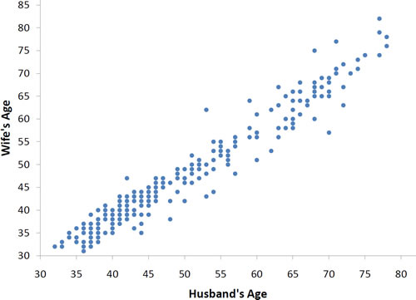
Scatter Plots
Taken from Wikipedia

Slide 27
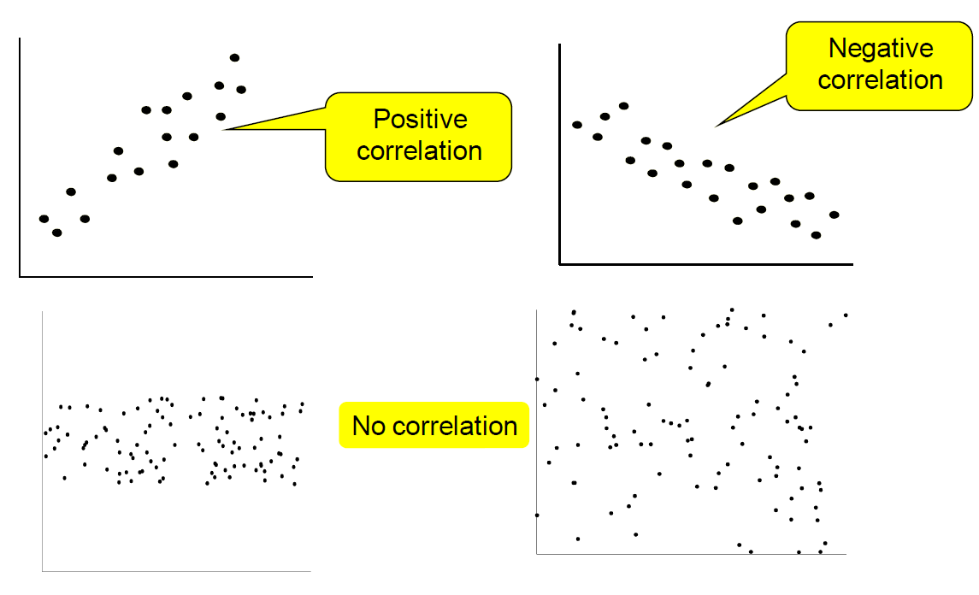
Correlated And Uncorrelated Data
Taken from Prof. Mark Last Lecture

Slide 28

Data Cleaning
“Data cleaning is one of the three biggest problems in data warehousing”—Ralph Kimball
Data Cleaning Tasks:
Fill in missing values
Identify Outliers
Smooth out noisy data
Correct Inconsistent Data
Resolve redundancies caused by data integration
Notes:
redundancies caused by data integration - same values in different formats, different columns with similar values, etc.

Slide 29

Missing Data
Data is not always available
E.g., many tuples have no recorded value for several attributes, such as customer income in sales data
Missing data may be due to
equipment malfunction
inconsistent with other recorded data and thus deleted
data not entered due to misunderstanding
certain data may not be considered important at the time of entry
not register history or changes of the data
Missing data may need to be inferred.

Slide 30
How to Handle Missing Data ?
Ignore the tuple:
usually done when class label is missing (assuming the task is classification—not effective when the percentage of missing values per attribute varies considerably)
Fill in the missing value manually:
tedious + infeasible ?
Fill in it automatically with:
a global constant : e.g., ―unknown‖, a new class?!
the attribute mean
the attribute mean for all samples belonging to the same class: smarter
the most probable value: inference-based such as regression, Bayesian formula or decision tree

Slide 31

Noisy Data
Noise: random error or variance in a measured variable
Incorrect attribute values may due to
faulty data collection instruments
data entry problems
data transmission problems
technology limitation
inconsistency in naming convention

Slide 32
How to Handle Noisy Data ?
Binning
First sort data and partition into (equal-frequency) bins
Then one can smooth by bin means, smooth by bin median, smooth by bin boundaries, etc. When should I use each one?
Regression
Smooth by fitting the data into regression functions
Clustering
Detect and remove outliers
Combined computer and human inspection
Detect suspicious values and check by human (e.g., deal with possible outliers)

Slide 33
Binning
Equal-width (distance) partitioning
Divides the range into N intervals of equal size: uniform grid
if A and B are the lowest and highest values of the attribute, the width of intervals will be: W = (B –A)/N
The most straightforward, but outliers may dominate presentation
Skewed data is not handled well
Equal-depth (frequency) partitioning
Divides the range into N intervals, each containing approximately same number of samples
Good data scaling
Unequal intervals may be hard to use
Managing categorical attributes can be tricky

Slide 34
Binning Methods For Data Smoothing
Sorted data for price (in dollars): 4, 8, 9, 15, 21, 21, 24, 25, 26, 28, 29, 34
Partition into three equal-frequency (equi-depth) bins (the number of intervals may be chosen manually or automatically):
Bin 1: 4, 8, 9, 15
Bin 2: 21, 21, 24, 25
Bin 3: 26, 28, 29, 34
Smoothing by bin means:
Bin 1: 9, 9, 9, 9
Bin 2: 23, 23, 23, 23
Bin 3: 29, 29, 29, 29
Smoothing by bin boundaries:
Bin 1: 4, 4, 4, 15
Bin 2: 21, 21, 25, 25
Bin 3: 26, 26, 26, 34

Slide 35
Regression
y
Y1
Y1’
y = x + 1
X1
x

Slide 36
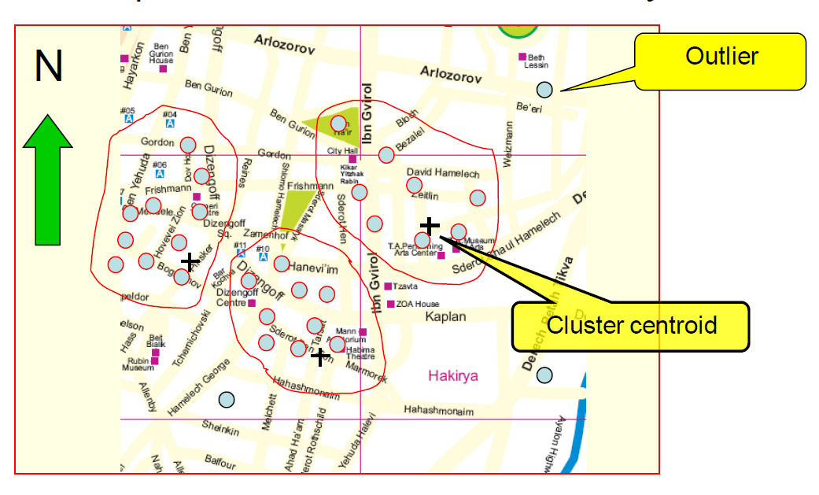
Cluster Analysis – Detect Outliers
Taken from Prof. Mark Last Lecture

Slide 37
Data Integration
Data integration:
Combines data from multiple sources into a coherent store
Schema integration: e.g., A.cust-id ≡ B.cust-#
Integrate metadata from different sources
Entity identification problem:
Identify real world entities from multiple data sources, e.g., Bill Clinton = William Clinton
Detecting and resolving data value conflicts
For the same real world entity, attribute values from different sources are different
Possible reasons: different representations, different scales, e.g., metric vs. British units

Slide 38
Handling Redundancy in Data Integration
Redundant data occur often when integration of multiple databases
Object identification: The same attribute or object may have different names in different databases
Derivable data: One attribute may be a “derived” attribute in another table, e.g., annual revenue
Redundant attributes may be able to be detected by correlation analysis
Careful integration of the data from multiple sources may help reduce/avoid redundancies and inconsistencies and improve mining speed and quality

Slide 39
Correlation Analysis (Numerical Data)
Correlation coefficient (also called Pearson’s product moment coefficient)
where n is the number of tuples, and are the respective means of A and B, σ_{A} and σ_{B} are the respective standard deviation of A and B, and Σ(AB) is the sum of the AB cross-product.
If r_{A,B} > 0, A and B are positively correlated (A’s values increase as B’s). The higher, the stronger correlation.
r_{A,B} = 0: independent; r_{A,B} < 0: negatively correlated
39

Slide 40
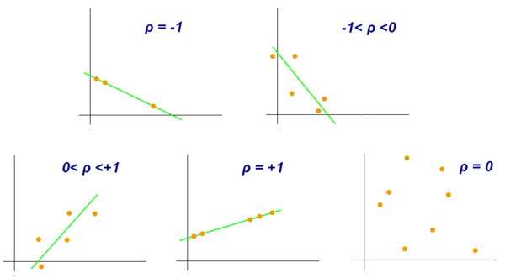
Correlation Analysis (Numerical Data)
40

Slide 41
Correlation Analysis (Categorical Data)
Χ² (chi-square) test
The larger the Χ² value, the more likely the variables are related
The cells that contribute the most to the Χ² value are those whose actual count is very different from the expected count
Correlation does not imply causality
# of hospitals and # of car-theft in a city are correlated
Both are causally linked to the third variable: population
41

Slide 42
Chi-Square Calculation: An Example
Χ² (chi-square) calculation (numbers in parenthesis are expected counts calculated based on the data distribution in the two categories)
It shows that like_science_fiction and play_chess are correlated in the group
 | Play chess | Not play chess | Sum (row)
Like science fiction | 250(90) | 200(360) | 450
Not like science fiction | 50(210) | 1000(840) | 1050
Sum(col.) | 300 | 1200 | 1500
42

Slide 43
Data Transformation
Smoothing: remove noise from data
Aggregation: summarization, data cube construction
Generalization: concept hierarchy climbing
Normalization: scaled to fall within a small, specified range
min-max normalization
z-score normalization
normalization by decimal scaling
Attribute/feature construction
New attributes constructed from the given ones

Slide 44
Data Transformation: Normalization
Min-max normalization: to [new_min_{A}, new_max_{A}]
Ex. Let income range $12,000 to $98,000 normalized to [0.0, 1.0]. Then $73,000 is mapped to
Z-score normalization (μ: mean, σ: standard deviation):
Ex. Let μ = 54,000, σ = 16,000. Then
44

Slide 45
Data Reduction Strategies
Why data reduction?
A database/data warehouse may store terabytes of data
Complex data analysis/mining may take a very long time to run on the complete data set
Data reduction
Obtain a reduced representation of the data set that is much smaller in volume but yet produce the same (or almost the same) analytical results
Data reduction strategies
Data cube aggregation:
Dimensionality reduction — e.g., remove unimportant attributes
Data Compression
Numerosity reduction — e.g., fit data into models
Discretization and concept hierarchy generation

Slide 46
Data Cube Aggregation
The lowest level of a data cube (base cuboid)
The aggregated data for an individual entity of interest
E.g., a customer in a phone calling data warehouse
Multiple levels of aggregation in data cubes
Further reduce the size of data to deal with
Reference appropriate levels
Use the smallest representation which is enough to solve the task
Queries regarding aggregated information should be answered using data cube, when possible

Slide 47
Attribute Subset Selection
Feature selection (i.e., attribute subset selection):
Select a minimum set of features such that the probability distribution of different classes given the values for those features is as close as possible to the original distribution given the values of all features

Slide 48
Heuristic Feature Selection Methods
There are 2^{d} possible sub-features of d features
Several heuristic feature selection methods:
Best single features under the feature independence assumption: choose by significance tests
Best step-wise feature selection:
The best single-feature is picked first
Then next best feature condition to the first, ...
Step-wise feature elimination:
Repeatedly eliminate the worst feature
Best combined feature selection and elimination
Optimal branch and bound:
Use feature elimination and backtracking
Decision-tree induction

Slide 49
Example of Decision Tree Induction
Initial attribute set:
{A1, A2, A3, A4, A5, A6}
A4 ?
A1?
A6?
Class 1
Class 2
Class 1
Class 2
>
Reduced attribute set: {A1, A4, A6}

Slide 50
Dimensionality Reduction: Principal Component Analysis (PCA)
Given N data vectors from n-dimensions, find k ≤ n orthogonal vectors (principal components) that can be best used to represent data
Steps
Normalize input data: Each attribute falls within the same range
Compute k orthonormal (unit) vectors, i.e., principal components
Each input data (vector) is a linear combination of the k principal component vectors
The principal components are sorted in order of decreasing “significance” or strength
Since the components are sorted, the size of the data can be reduced by eliminating the weak components, i.e., those with low variance. (i.e., using the strongest principal components, it is possible to reconstruct a good approximation of the original data
Works for numeric data only
Used when the number of dimensions is large

Slide 51
Principal Component Analysis
X2
Y1
Y2
X1

Slide 52
Numerosity Reduction
Reduce data volume by choosing alternative, smaller forms of data representation
Parametric methods
Assume the data fits some model, estimate model parameters, store only the parameters, and discard the data (except possible outliers)
Example: Log-linear models—obtain value at a point in m-D space as the product on appropriate marginal subspaces
Non-parametric methods
Do not assume models
Major families: histograms, clustering, sampling

Slide 53
Data Reduction Method (1): Regression and Log-Linear Models
Linear regression: Data are modeled to fit a straight line
Often uses the least-square method to fit the line
Multiple regression: allows a response variable Y to be modeled as a linear function of multidimensional feature vector
Log-linear model: approximates discrete multidimensional probability distributions

Slide 54
Regress Analysis and Log-Linear Models
Linear regression: Y = w X + b
Two regression coefficients, w and b, specify the line and are to be estimated by using the data at hand
Using the least squares criterion to the known values of Y1, Y2, …, X1, X2, ….
Multiple regression: Y = b0 + b1 X1 + b2 X2.
Many nonlinear functions can be transformed into the above
Log-linear models:
The multi-way table of joint probabilities is approximated by a product of lower-order tables
Probability: p(a, b, c, d) = αab βacχad δbcd

Slide 55
Data Reduction Method (2): Histograms
Divide data into buckets and store average (sum) for each bucket
Partitioning rules:
Equal-width: equal bucket range
Equal-frequency (or equal-depth)
V-optimal: with the least histogram variance (weighted sum of the original values that each bucket represents)

Slide 56
Data Reduction Method (3): Clustering
Partition data set into clusters based on similarity, and store cluster representation (e.g., centroid and diameter) only
Can be very effective if data is clustered but not if data is “smeared”
Can have hierarchical clustering and be stored in multi-dimensional index tree structures
There are many choices of clustering definitions and clustering algorithms
Cluster analysis will be studied in depth in Chapter 7

Slide 57
Data Reduction Method (4): Sampling
Sampling: obtaining a small sample s to represent the whole data set N
Allow a mining algorithm to run in complexity that is potentially sub-linear to the size of the data
Choose a representative subset of the data
Simple random sampling may have very poor performance in the presence of skew
Develop adaptive sampling methods
Stratified sampling:
Approximate the percentage of each class (or subpopulation of interest) in the overall database
Used in conjunction with skewed data
Note: Sampling may not reduce database I/Os (page at a time)

Slide 58
Sampling: with or without Replacement
SRSWOR
(simple random
sample without
replacement)
SRSWR
Raw Data

Slide 59
Sampling: Cluster or Stratified Sampling
Raw Data
Cluster/Stratified Sample

Slide 60
Summary
Data preparation or preprocessing is a big issue for both data warehousing and data mining
Descriptive data summarization is need for quality data preprocessing
Data preparation includes
Data cleaning and data integration
Data reduction and feature selection
Discretization
A lot a methods have been developed but data preprocessing still an active area of research

Slide 61
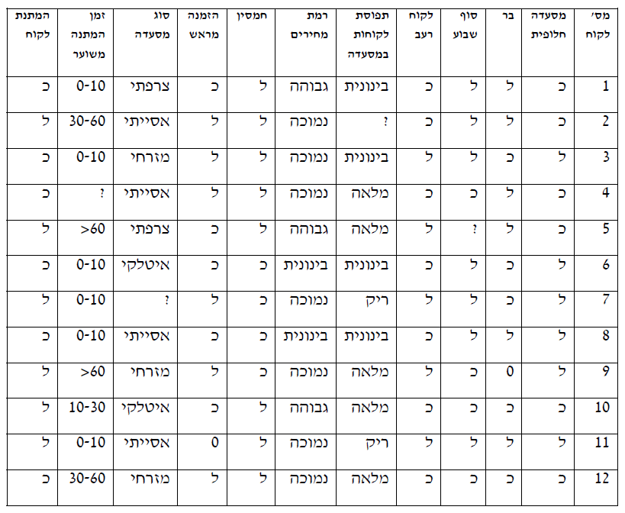
Exercise
להלן טבלת נתוני אימון. ציינו והדגימו את שלבי הכנת הנתונים לביצוע כריית מידע כדוגמת טיפול בערכים חסרים, ערכים שגויים ועוד.

Slide 62
Preprocessing with Weka Demo

